Slide 1
MIU LIBRARY

Slide 2
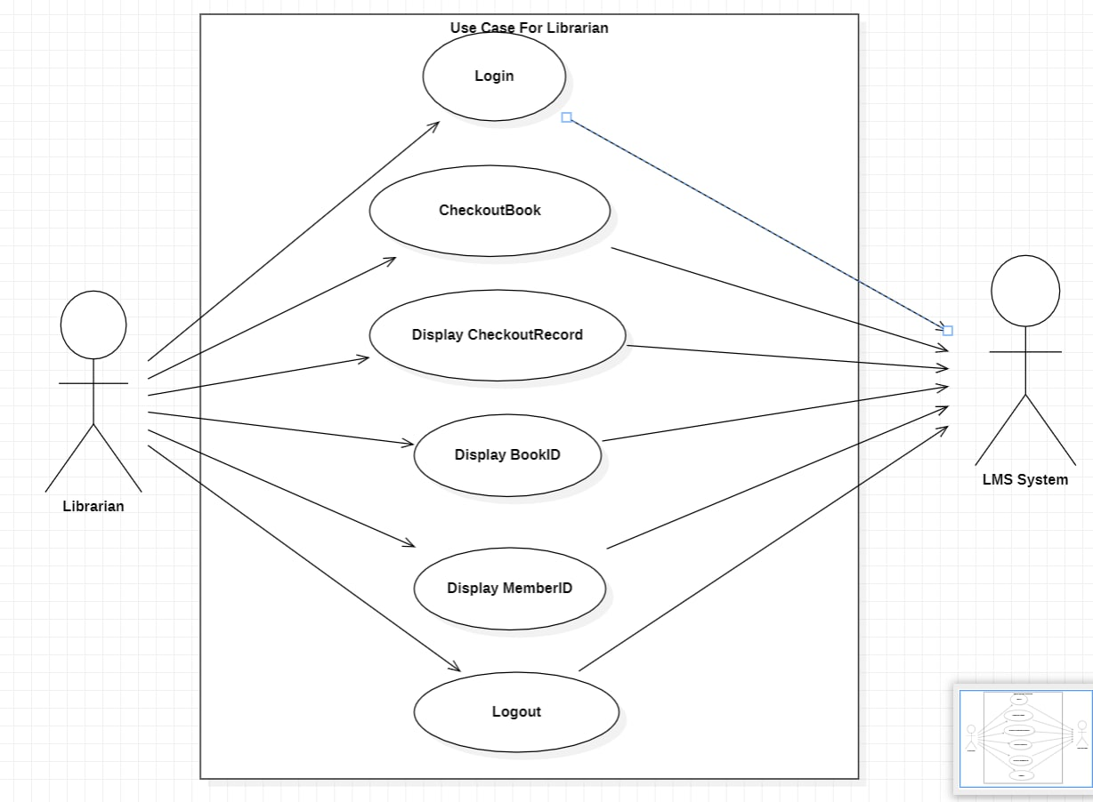
Librarian Use case

Slide 3
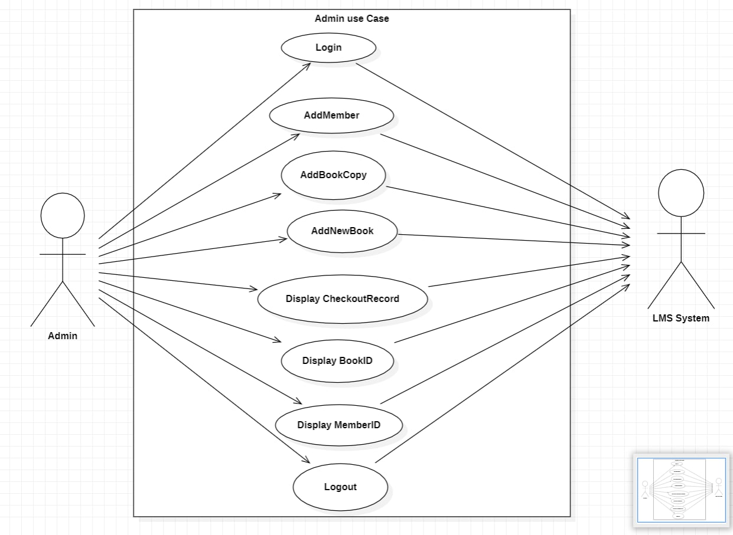
Admin Use case

Slide 4
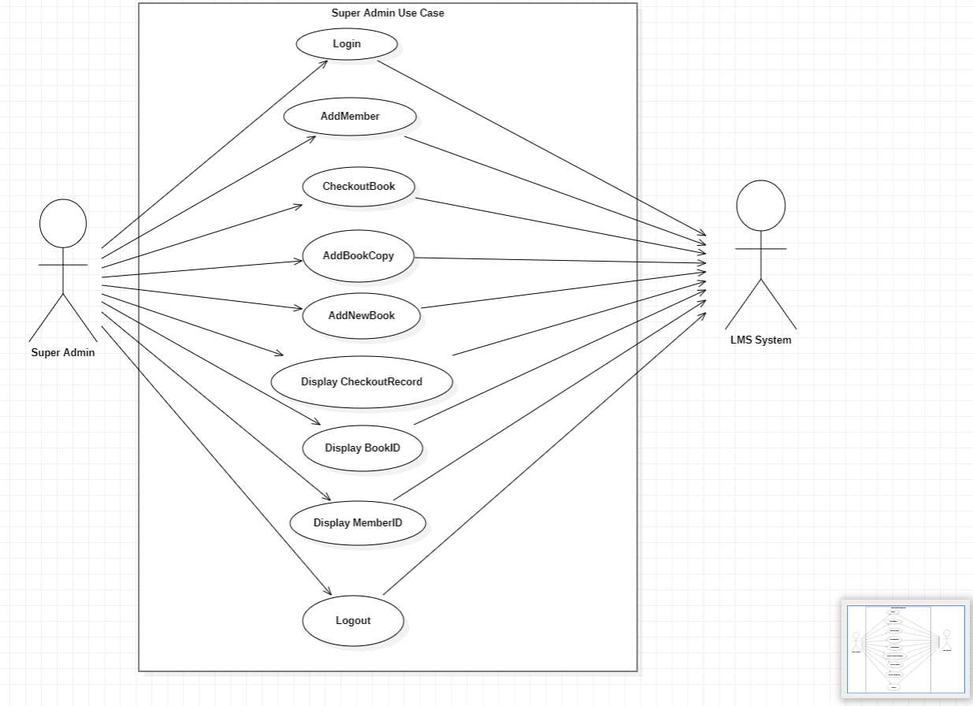
Super Admin Use case

Slide 5
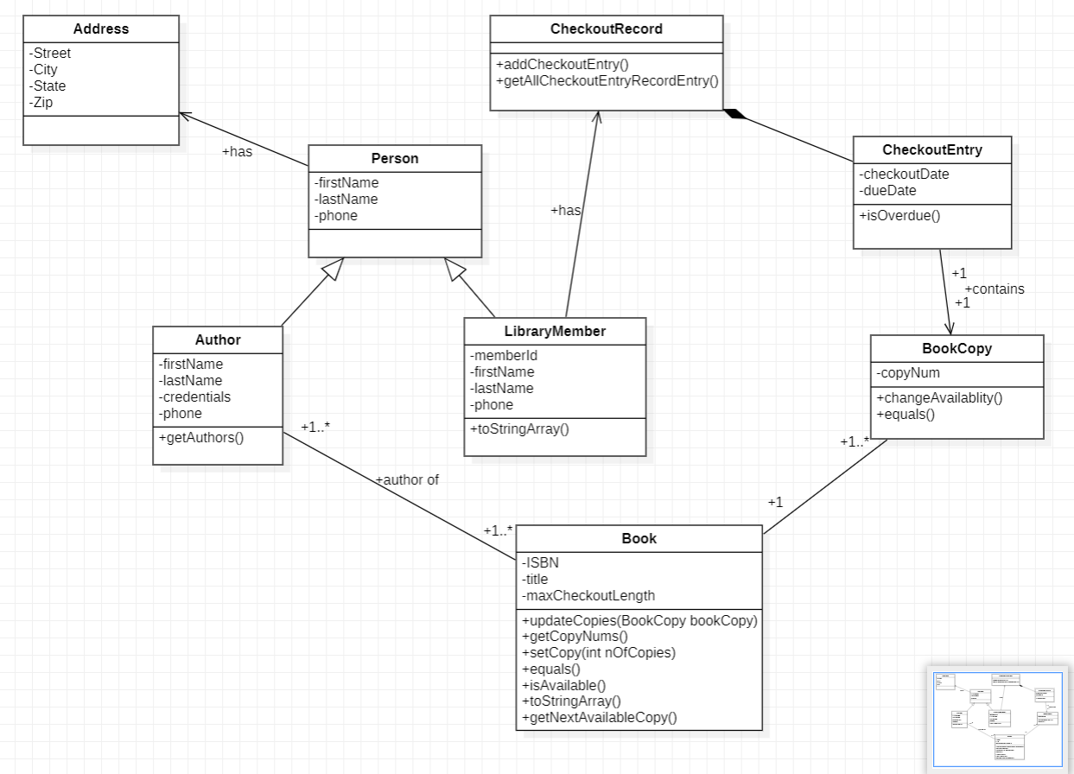
Class Diagram

Slide 6
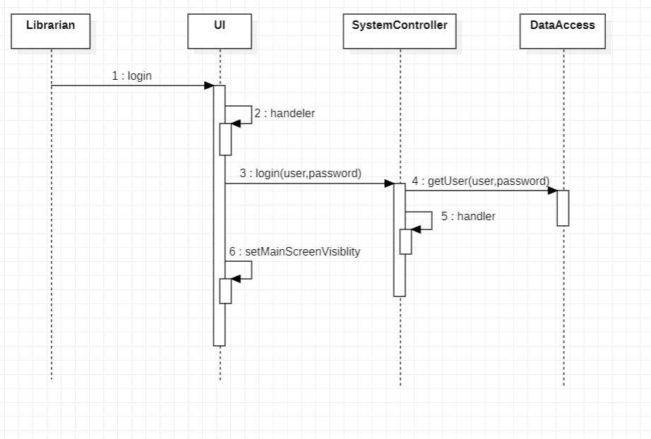
Login Sequence Diagram

Slide 7
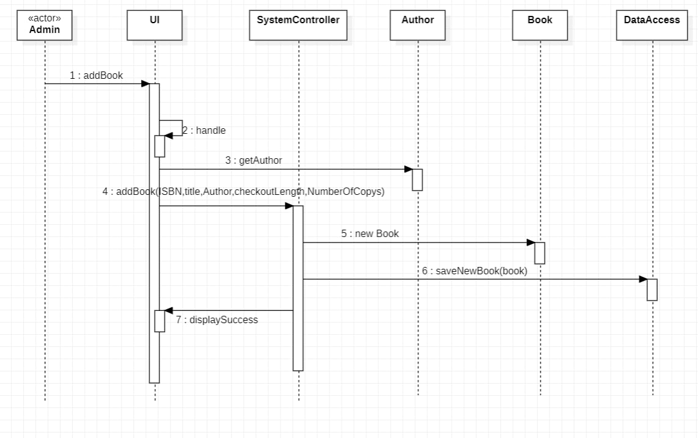
Add New Book Sequence Diagram

Slide 8
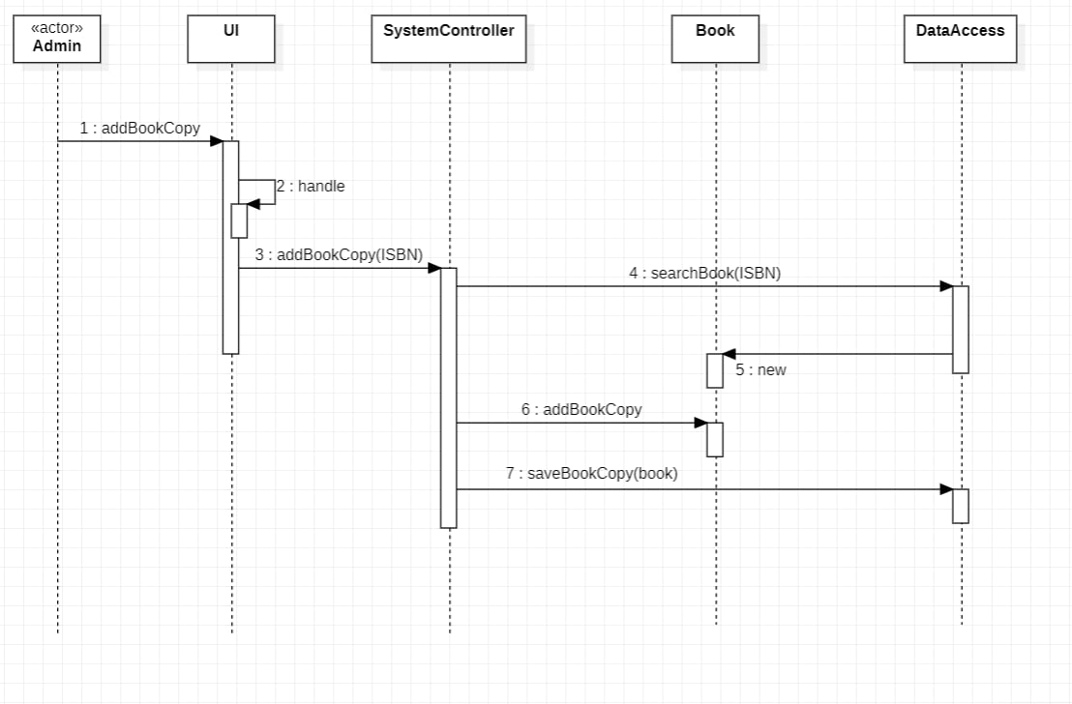
Add Book Copy Sequence Diagram

Slide 9
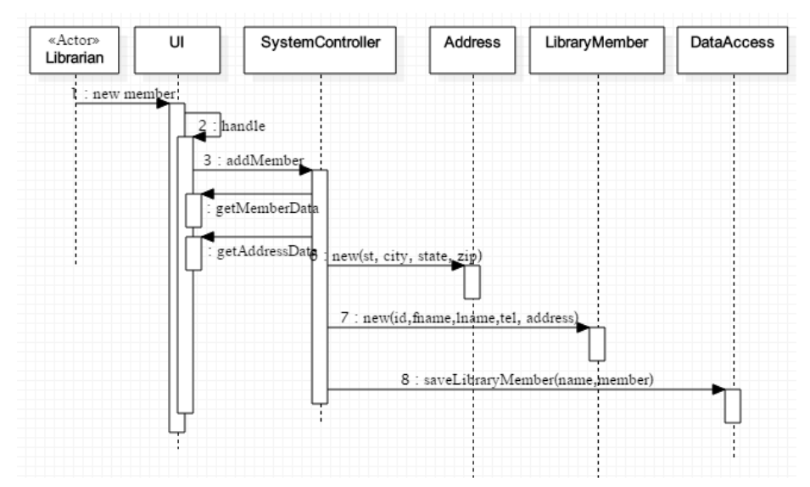
Add Member Sequence Diagram

Slide 10
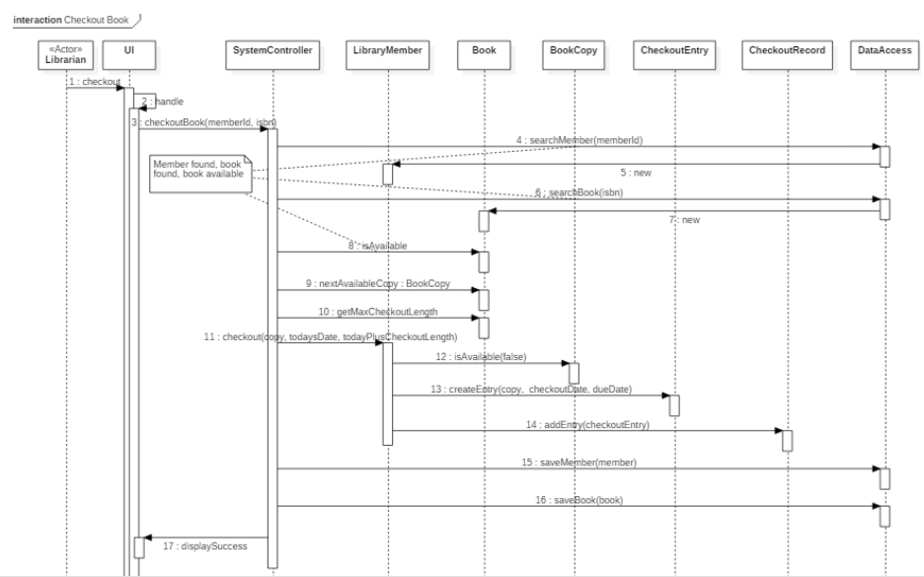
Checkout Book Sequence Diagram

Slide 11
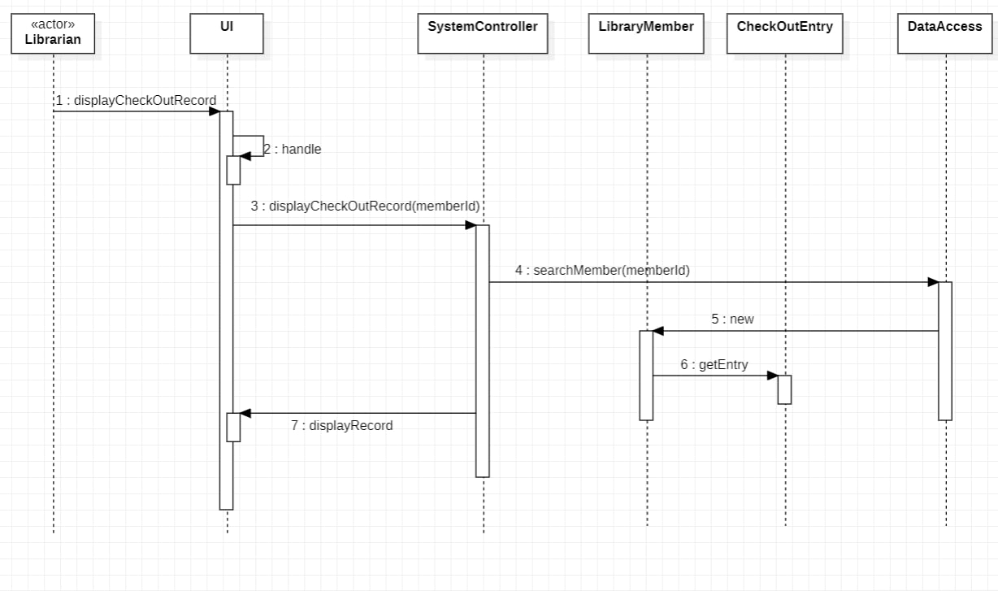
Checkout Record Sequence Diagram

Slide 12
Thank you !

